Slide 1
Eco 6380 Predictive Analytics For Economists Spring 2016
Professor Tom Fomby
Department of Economics
SMU

Slide 2
Presentation 2 The Data Mining Process and Four Software Packages Chapter 2 in SPB

Slide 3
The Data Mining Process
The CRISP_DM Paradigm (see CRISPWP_0800 Data Mining Standards.pdf; CRISP_DM.pdf; and CRISP_Wikipedia.pdf)
CRISP_DM = Cross Industry Standard Process for Data Mining
Steps:
Business Understanding
Data Understanding
Data Preparation
Modeling
Evaluation
Deployment
See the CRISP_DM tool in IBM/SPSS Modeler 15.0
The SAS Institute in Cary, North Carolina has its own Data Mining Process Protocol. It is called SEMMA. For more on this protocol, see SAS_SEMMA.pdf

Slide 4
A Look at Four Data Mining Software Packages
XLMINER – A very nice pedagogical software package to use. Part of your textbook. Add-in to Microsoft EXCEL. A Point and Click add-in that generates extra EXCEL spreadsheets when executing a procedure.
IBM/SPSS Modeler 15.0 – More sophisticated than XLMINER. It uses a “stream flow” approach where modeling “nodes” (icons) are drawn from a palate and put on a “canvas.” Then the nodes are connected together to form a “stream” to conduct a task required by the user. This package is available in Apps.SMU or for download. See the instructions provided in the pdf file “INSTRUCTIONS FOR USING SPSS AND SAS WITH AppSMU_edu.pdf” for using SPSS Modeler 15 on VCL (Apps.SMU). If you want to download SPSS Modeler to your laptop or PC, you must have a valid SMU ID and follow the instructions in “Instructions for Downloading SPSS Modeler with Valid SMU ID.pdf”.
SAS Enterprise Miner 7.1 Workstation – Currently not available on VCL but is available for download. Ask at the SMU OIT help desk for the instructions for downloading it to your laptop or PC with valid SMU ID.
All of the three above software packages have sample data sets.
Also the “Open Source” software R is becoming increasingly popular as a data mining software tool.

Slide 5
Some General Observations
Most Computer Scientists and Engineers are not trained in Statistics
Most Statisticians and Econometricians are not trained in Data Warehousing Techniques
Most Offices of Information Technology are not using statistical methods to be forward-looking or proactive with respect to their customers and business operations
Properly Reporting Predictive Analytics Results to a Lay Audience is crucial in getting buy-in and utilization of analytics results in company operations
Many Technical People are not well schooled in presentation skills

Slide 6
Successful Implementation of Predictive Analytics into company operations requires a combination of three Basic Core Competencies
Predictive Analytics
Reporting
Data Warehousing

Slide 7
To Operate Core Competencies
Data Warehousing: D-base, Oracle, etc.
Predictive Analytics: SPSS Modeler and Other Statistical Packages
Reporting – Cognos for Dashboards and Microsoft PowerPoint

Slide 8
Prerequisite Skills for a Skilled Analytics Person
Essential Tools
for
Predictive Analytics
Generalized
Linear
Modeling
Time Series Analysis
Applied Multivariate Analysis
Machine Learning Tools
Computational Skills
Multiple
Regression

Slide 9
Some Specifics on Skills
Multiple Linear Regression (OLS, WLS, Time Series Regressions)
Generalized Linear Modeling (Probit, Logit, Multinomial Logit/Probit, Count, Cox Proportional Hazard models)
Time Series Modeling Expertise (Seasonal Adjustment, Box-Jenkins, Exponential Smoothing, Vector Autoregressions)
Applied Multivariate Statistical Analysis (Clustering, Principal Components, Discriminant Analysis)
Training in Machine Learning Tools (CART, CHAID, SVM, ANN, K-Nearest-Neighbors, Association Rules)
Computer Usage and Programming Skills (SPSS Modeler, SAS Enterprise Miner, Matlab, Mathematica, R, STATA, EVIEWS)

Slide 10
Core Tasks of Predictive Analytics
EDA
Univariate Plots
Box-Plots
Matrix Plots
Heat and Spatial Maps
Unsupervised
Learning
Treatment of Missing Observations
Treatment of Outliers
Data Segmentation
Reduction of Dimension of Input Space
Supervised
Learning
Prediction of Numeric Targets
Prediction of Categorical Targets
Scoring of New Data
Continual Supervision of Model Performance

Slide 11
A Bond Rating Problem
In this problem imagine yourself as a Bond Rating Analyst working for BondRate, Inc., a National Bond Rating Company. Given the financials of a company that is about to issue a corporate bond, you are to rate its bond with a rating of AAA (highest rating), AA, A, BBB, BB, B, or C (lowest rating) depending on the probability that the company will not be “financially stressed” in the next 12 months. In our rating system, if the company has a probability between 0.0 and 0.05 of being distressed in the next 12 months, the firm’s bond is rated AAA. If the company has a probability between 0.05 and 0.10 of being distressed in the next 12 months, the firm’s bond is rated AA. The ranges for the other ratings are A = (0.10 – 0.15), BBB = (0.15 – 0.20), BB = (0.20 – 0.25), B = (0.25 – 0.30), and C = (0.30 and above).
Target Variable: Y = 0 if firm does not become “distressed” in the next 12 months, Y = 1 if firm becomes distressed in the next 12 months
Input Variables include (next slide)

Slide 12
Input Variables Measured 12 Months Prior
tdta = "Debt to Assets"
gempl = "Employee Growth Rate"
opita = "Op. Income to Assets"
invsls = "Inventory to Sales"
lsls = "Log of Sales"
lta = "Log of Assets"
nwcta = "Net Working Cap to Assets"
cacl = "Current Assets to Current Liab"
qacl = "Quick Assets to Current Liab"
ebita = "EBIT to Assets"
reta = "Retained Earnings to Assets"
ltdta = "LongTerm Debt to TotAssets"
mveltd = "Mkt Value Eqty to LTD"
fata = "Fixed Assets to Assets";

Slide 13
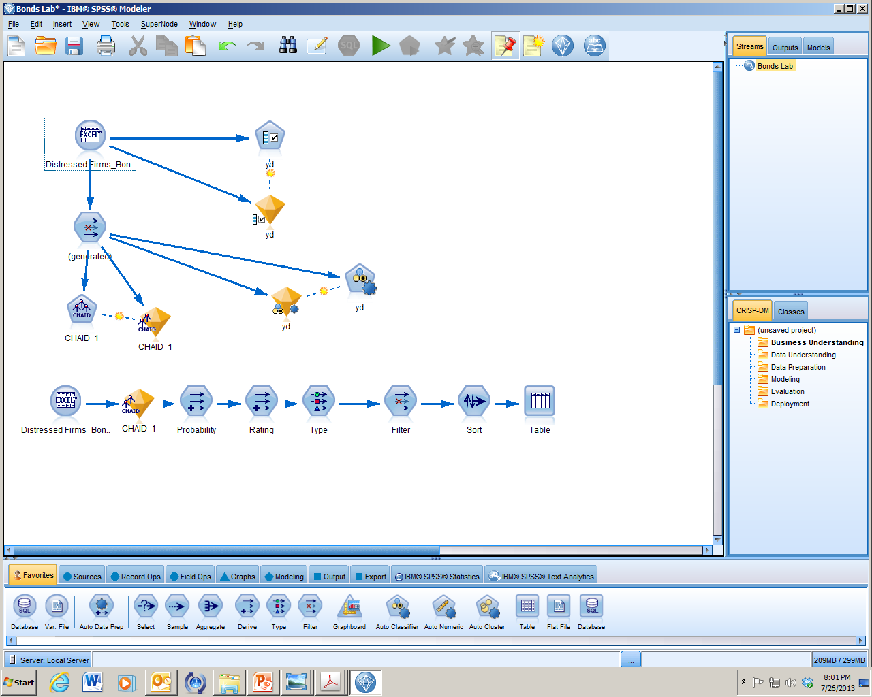
A Typical SPSS Modeler Stream

Slide 14
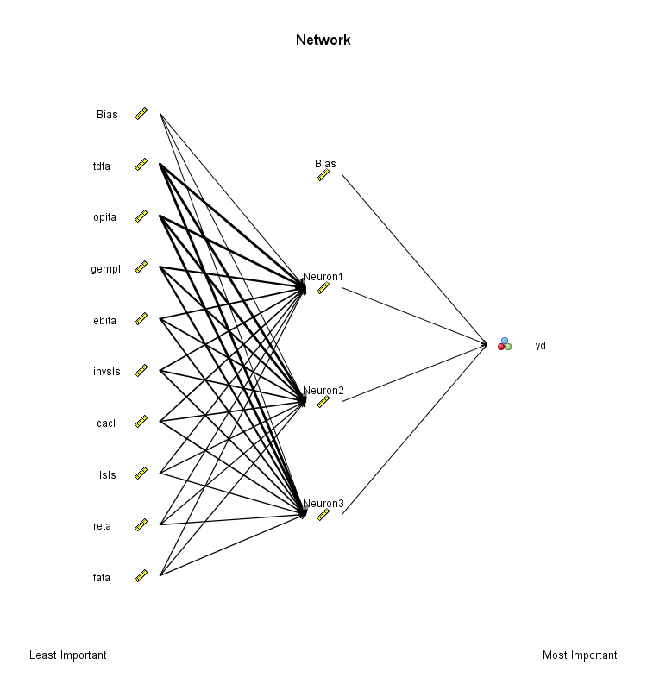
An Artificial Neural Network

Slide 15
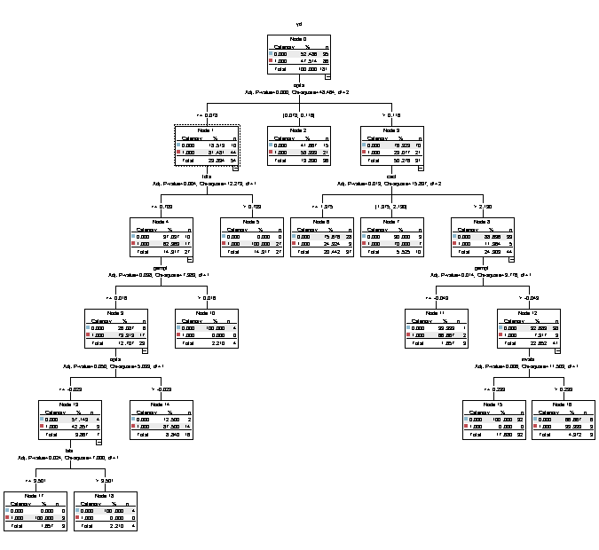
A CHAID Tree

Slide 16
Now Review the Operation of XLMINER Software

